Slide 1

Department of Information Technology
NBA Accredited A.P. Shah Institute of Technology G.B.Road,Kasarvadavli, Thane(W), Mumbai-400615 UNIVERSITY OF MUMBAI Academic Year 2021-2022

Slide 2
A Project Presentation on Heart Disease Detection System Submitted in partial fulfilment of the degree of Bachelor of Engineering(Sem-6)
in INFORMATION TECHNOLOGY By Samiksha Pawar (19104020) Shreyasha Vinerkar (19104032) Ragini Pandey (18104065)
Under the Guidance of Prof.Mansi Choche

Slide 3
1.Project Conception and Initiation

Slide 4
1.1 Objectives
• The main objective of this research is to develop a heart prediction system. The system can
discover and extract hidden knowledge associated with diseases from a historical heart data set
Provides new approach to concealed patterns in the data.
• Helps avoid human biasness.
• To implement Logistic Regression that classifies the disease as per the input of the user.
• Reduce the cost of medical tests.

Slide 5
1.2 Literature Review
(Beyene & Kamat, 2018) ⁠recommended different algorithms like Naive Bayes, Classification Tree, KNN, Logistic Regression, SVM and ANN. The Logistic Regression gives better accuracy compared to other algorithms.
(Beyene & Kamat, 2018) ⁠ suggested Heart Disease Prediction
System using Data Mining Techniques
(A & Naik, 2016) ⁠ recommended to develop the prediction system which will diagnosis the heart
disease from patient’s medical data set. 13 risk factors of input attributes have considered to build
the system. After analysis of the data from the dataset, data cleaning and data integration was
performed. He used k-means and naïve Bayes to predict heart disease. This paper is to build the
system using historical heart database that gives diagnosis.

Slide 6
1.3 Problem Definition
The major challenge in heart disease is its detection. There are instruments available which can predict heart disease but either they are expensive or are not efficient to calculate chance of heart disease in human.
However, it is not possible to monitor patients every day in all cases accurately and consultation of a patient for 24 hours by a doctor is not available since it requires more sapience, time and expertise.
Since we have a good amount of data in today’s world, we can use various machine learning algorithms to analyze the data for hidden patterns. The hidden patterns can be used for health diagnosis in medicinal data.

Slide 7
1.4 Scope
The integration of clinical decision support with computer-based patient records could reduce medical errors, enhance patient safety, decrease unwanted practice variation, and improve patient outcome.
The potential to generate a knowledge-rich environment which can help to significantly improve the quality of clinical decisions.

Slide 8
1.5 Technology stack
Jupyter Notebook
Google Collab
Python 3.10.2
Pandas
Numpy
Flask
HTML
CSS

Slide 9
2. Project Design

Slide 10
2.1 Proposed System
In this system we are implementing heart disease prediction using Logistic Regression Algorithm.
Input can be given through manual entry and CSV dataset file , after taking the input the algorithm applied on the input is Logistic expression.
The proposed system will add some more parameters significant to heart attack with their weight, age and the priority levels are by consulting expertise doctors and the medical experts.

Slide 11
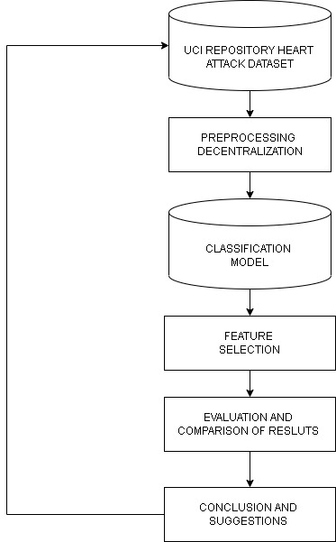
2.2 Design(Flow Of Modules)

Slide 12
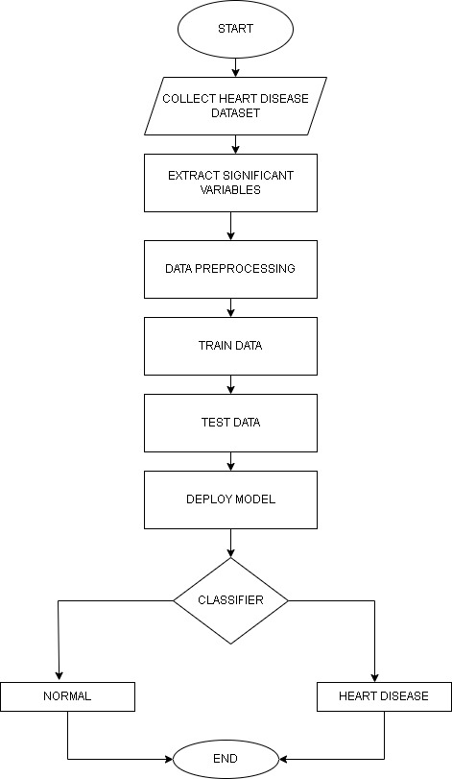

Slide 13
3. Implementation

Slide 14
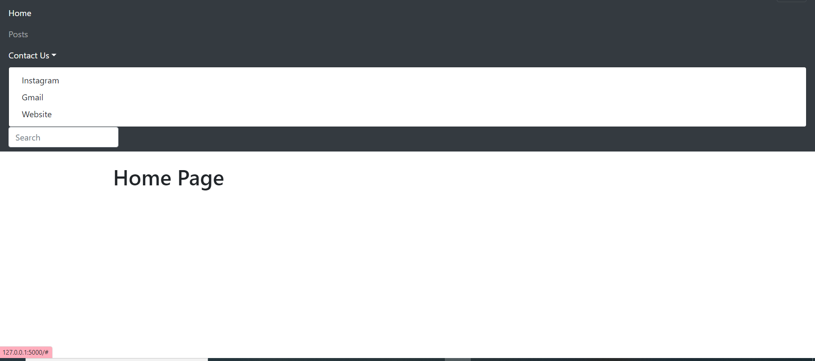

Slide 15
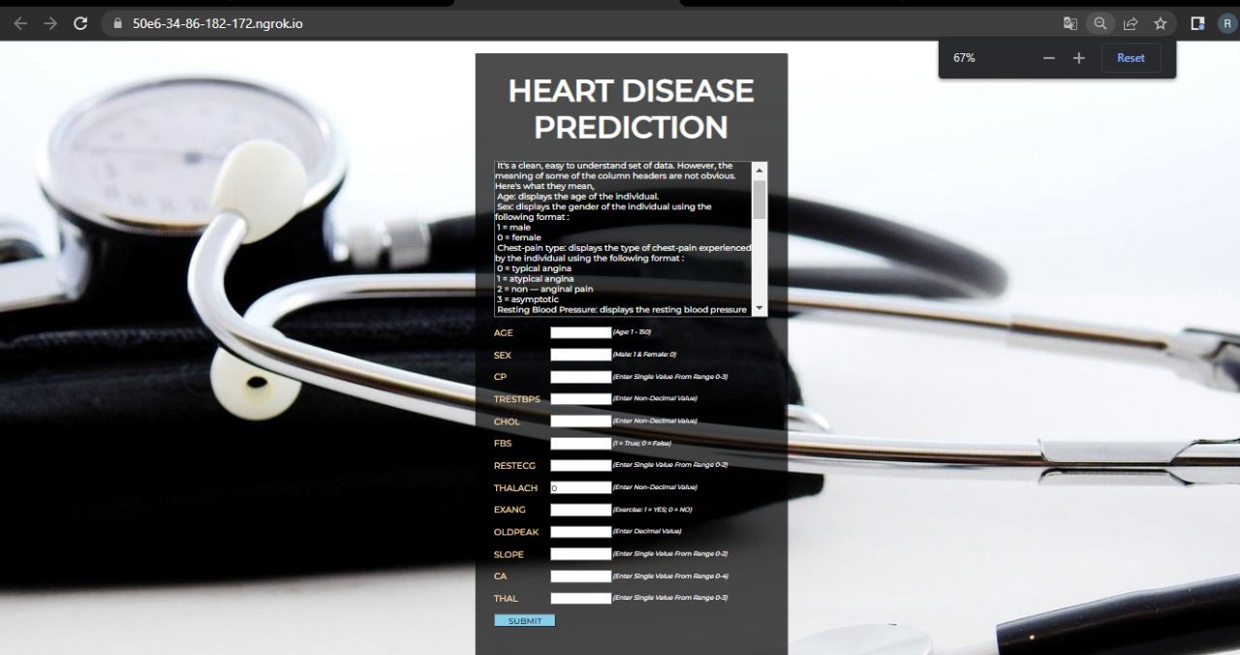
Implementation

Slide 16
5. Result
During the course of the project. We were able to make a heart disease detection system using Logistic Regression.

Slide 17
6. Conclusion and Future Scope

Slide 18
6.1 Conclusion
The use of machine learning techniques can be applied to detection of heart-health status but different degrees of accuracy can be obtained. The study has shown the prediction accuracy of three machine learning models to predict the presence or absence of heart diseases.

Slide 19
6.2 Future Scope
The study will be extended to adapt the models to be used in mobile applications, it will also consider the identification of various categories of heart diseases.
We can also add diet recommendation features according to the category of the heart disease detected.

Slide 20
References
A, A. S., & Naik, C. (2016). Different Data Mining Approaches for Predicting Heart Disease, 277–281. https://doi.org/10.15680/IJIRSET.2016.0505545
Beyene, C., & Kamat, P. (2018). Survey on prediction and analysis the occurrence of heart disease using data mining techniques. International Journal of Pure and Applied Mathematics, 118(Special Issue 8), 165–173. Retrieved from https://www.scopus.com/inward/record.uri?eid=2-s2.0-85041895038&partnerID=40&md5=2f0b0c5191a82bc0c3f0daf67d73bc81
https://www.researchgate.net/publication/331589020_Heart_Disease_Prediction_System
Kirmani, M. (2017). Cardiovascular Disease Prediction using Data Mining Techniques. Oriental Journal of Computer Science and Technology, 10(2), 520–528. https://doi.org/10.13005/ojcst/10.02.38
Polaraju, K., Durga Prasad, D., & Tech Scholar, M. (2017). Prediction of Heart Disease using Multiple Linear Regression Model. International Journal of Engineering Development and Research, 5(4), 2321–9939. Retrieved from www.ijedr.org

Slide 21
Thank You

